Slide 1



Joint Modeling of Exercise Response and Circadian Pattern in Transcriptome Dynamics for 15 Rat Tissues Alec Steep, Jiayu Zhang, Yanling Zhang, Jun Z. Li & Charles Burant

Slide 2
Today’s Talk
Purpose and Design of Study
Measurement of Exercise Response
The Problem: Confounding
Circadian Effects on Gene Expression
Simultaneous Measurement of Exercise & Circadian Pattern
Joint Modeling

Slide 3
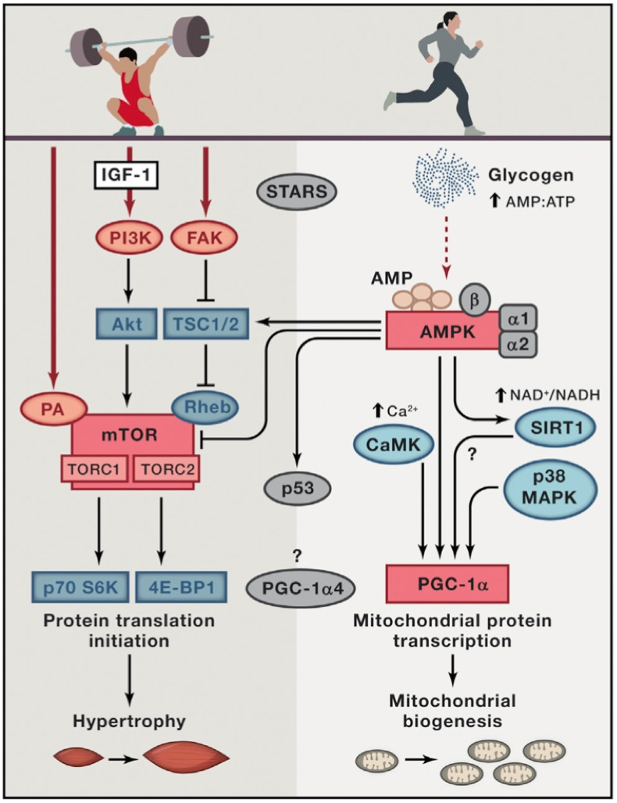
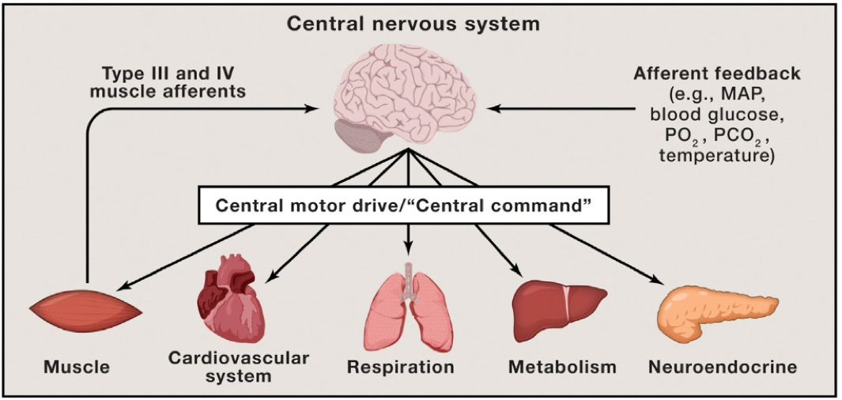
Molecular Transducers of Physical ACtivity (MoTrPAC)
﻿Hawley, J. A., Hargreaves, M., Joyner, M. J. & Zierath, J. R. Integrative biology of exercise. Cell 159, 738–749 (2014).

Slide 4
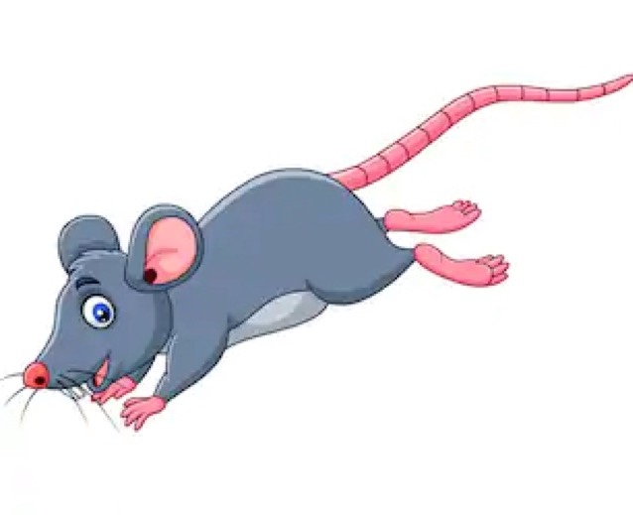
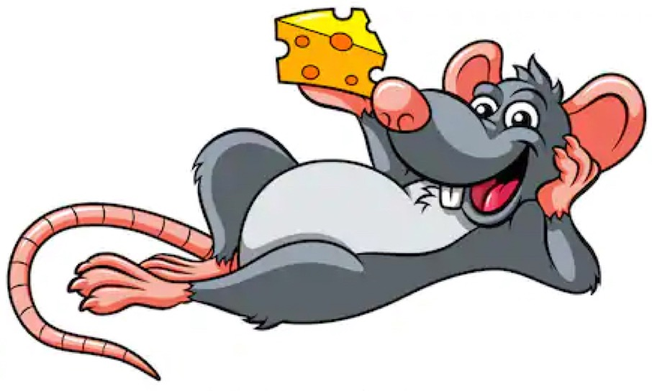
Experimental Design
PASS phase 1A: Acute Exercise Time Course Study
Acute Exercise Cohorts
7 time points collected (IPE, 0.5hr, 1hr, 4hr, 7hr, 24hr, 48hr)
Male Rat
Female Rat
Acute Bout: running at 18m/min,
5 degrees grade for 30 min.
0hr
1/2hr
1hr
4hr
7hr
24hr
48hr
Sedentary Cohorts
Slide Design inspired by MoTrPAC PASS1A Animal Procedure & Nicole Gay (Stanford)

Slide 5
Experimental Design
78 Rats
Multi-tissue:
15 Tissues
Multi-omic:
RNASeq
Proteomics
Metabolomics
RRBS
Acute Exercise Cohorts
Male Rat
Female Rat
Acute Bout: running at 18m/min,
5 degrees grade for 30 min.
0hr
1/2hr
1hr
4hr
7hr
24hr
48hr
Sedentary Cohorts
Slide Design inspired by MoTrPAC PASS1A Animal Procedure & Nicole Gay (Stanford)

Slide 6
PASS1A RNASeq Sample Inventory by Tissue & Sequencing Batch
Notes:
78 by 15

Slide 7
Individuals per Tissue Exercised/Control Group by Sex
Figure generated by Jun Z. Li
Notes:
And across each of those groups of 78 rats, the primary of groups of interest (those of control and exercise were divided quite evenly across sexes, and nearly evenly across groups.

Slide 8
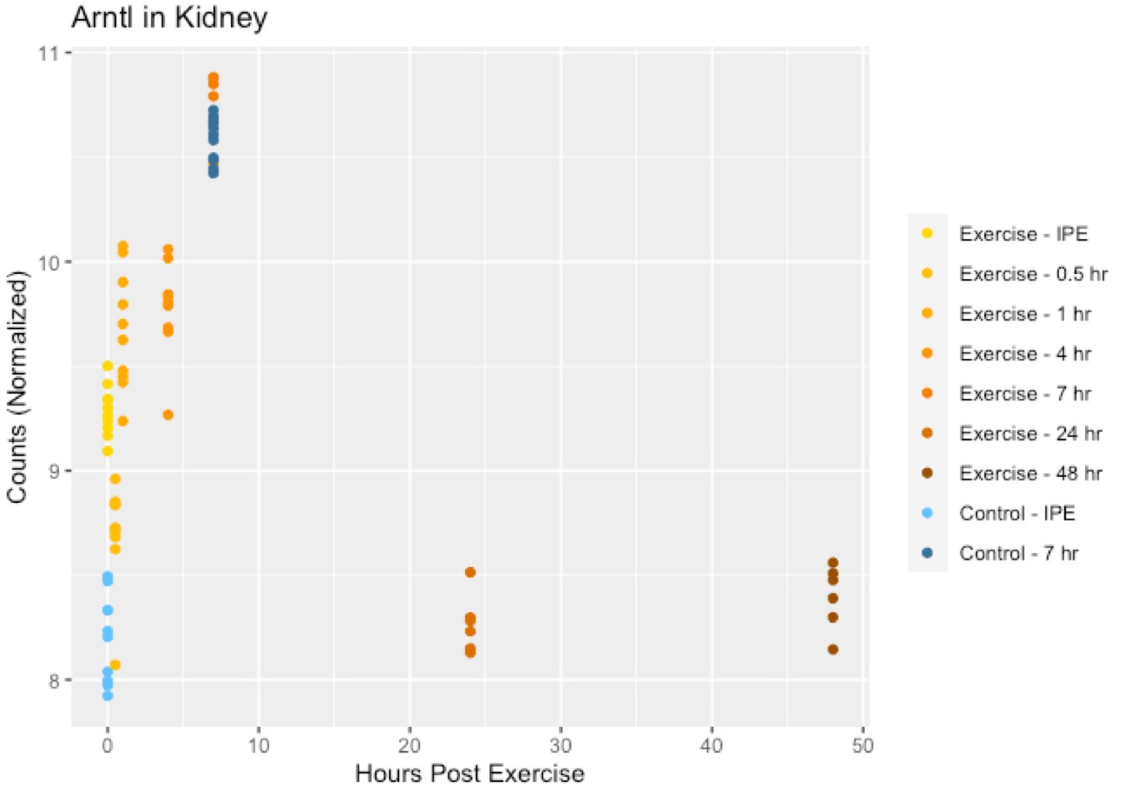
Example: Arntl in Kidney
Acute Exercise Cohorts
0hr
1/2hr
1hr
4hr
7hr
24hr
48hr
Sedentary Cohorts

Slide 9
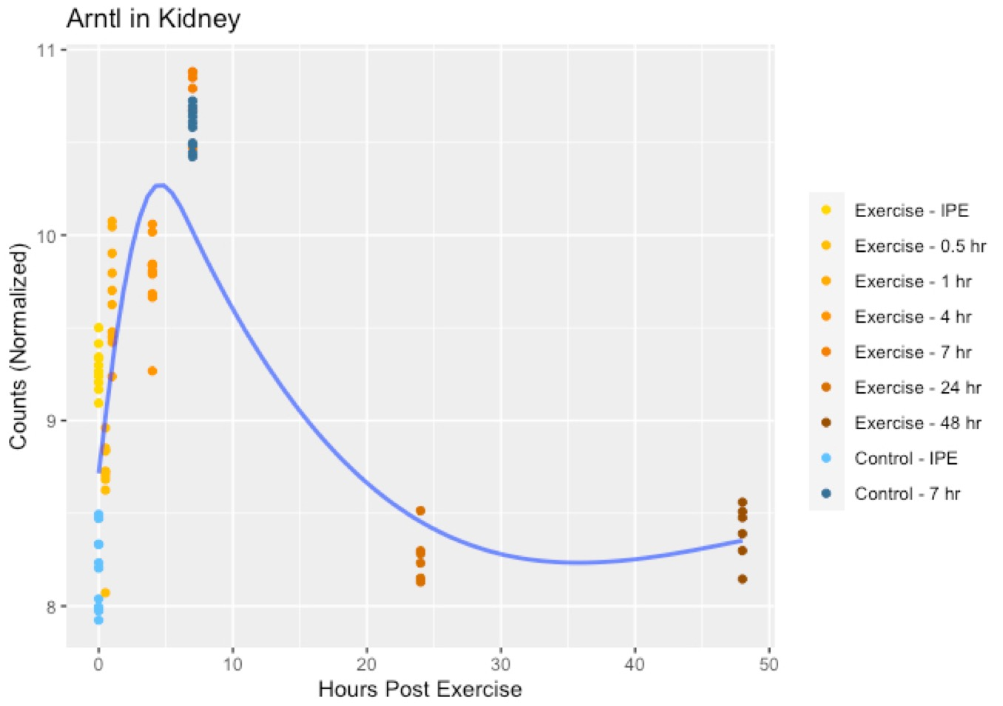
Model the Acute Exercise Response
Acute Exercise Cohorts
0hr
1/2hr
1hr
4hr
7hr
24hr
48hr
Sedentary Cohorts

Slide 10
Control Groups Demonstrate Differential Counts
Acute Exercise Cohorts
0hr
1/2hr
1hr
4hr
7hr
24hr
48hr
Sedentary Cohorts

Slide 11
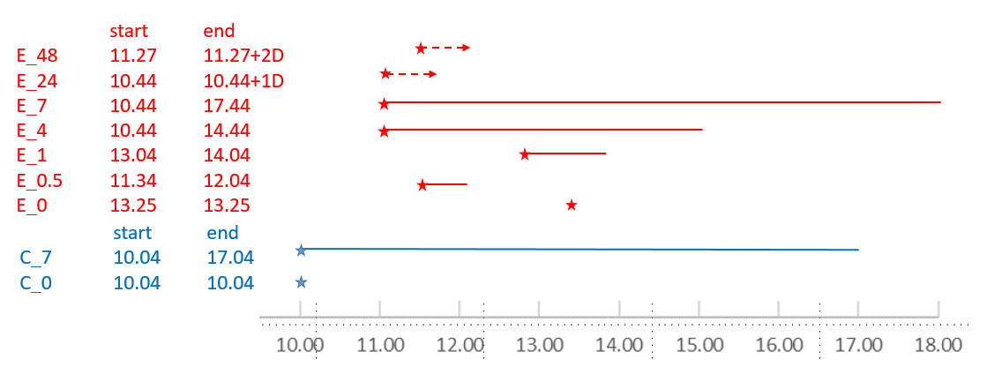


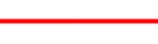

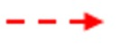
Two Time Frames: Time Post Exercise & Circadian Time
End of Event (Exercise/Control)
Time Between Event and Death
Time Between Event and Death ( >=24 hrs )
Notes:
Explain the 9 Groups

Slide 12
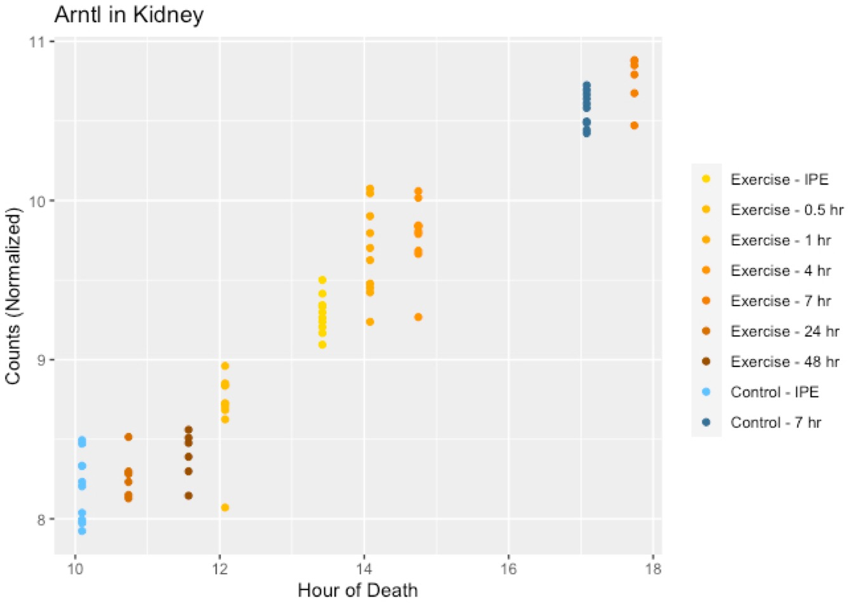
Measuring Exercised & Circadian Effects
Same data used to disentangle the two effects
Best modeled with 2 different time frames
Shuffle and rescale the x-axes
Hours Post Exercise
Time of Day

Slide 13
Measuring Exercised & Circadian Effects
Circadian patterns may interfere with detection of exercise response
Difficult to disentangle the two effects
Seven sampling points for the Exercised group
Two for the Control group
Which effect is dominant?
Avoid seeking Yes/No answers
Depends on the gene and the tissue
Notes:
Circadian patterns of gene expression may interfere with detection of exercise-induced changes
The PASS1A study had seven sampling points for the Exercised group, but inly two for the Control group, making it difficult to disentangle the two effects
Which effect is dominant? We should avoid seeking Yes/No answers, because it depends on the gene and the tissue

Slide 14
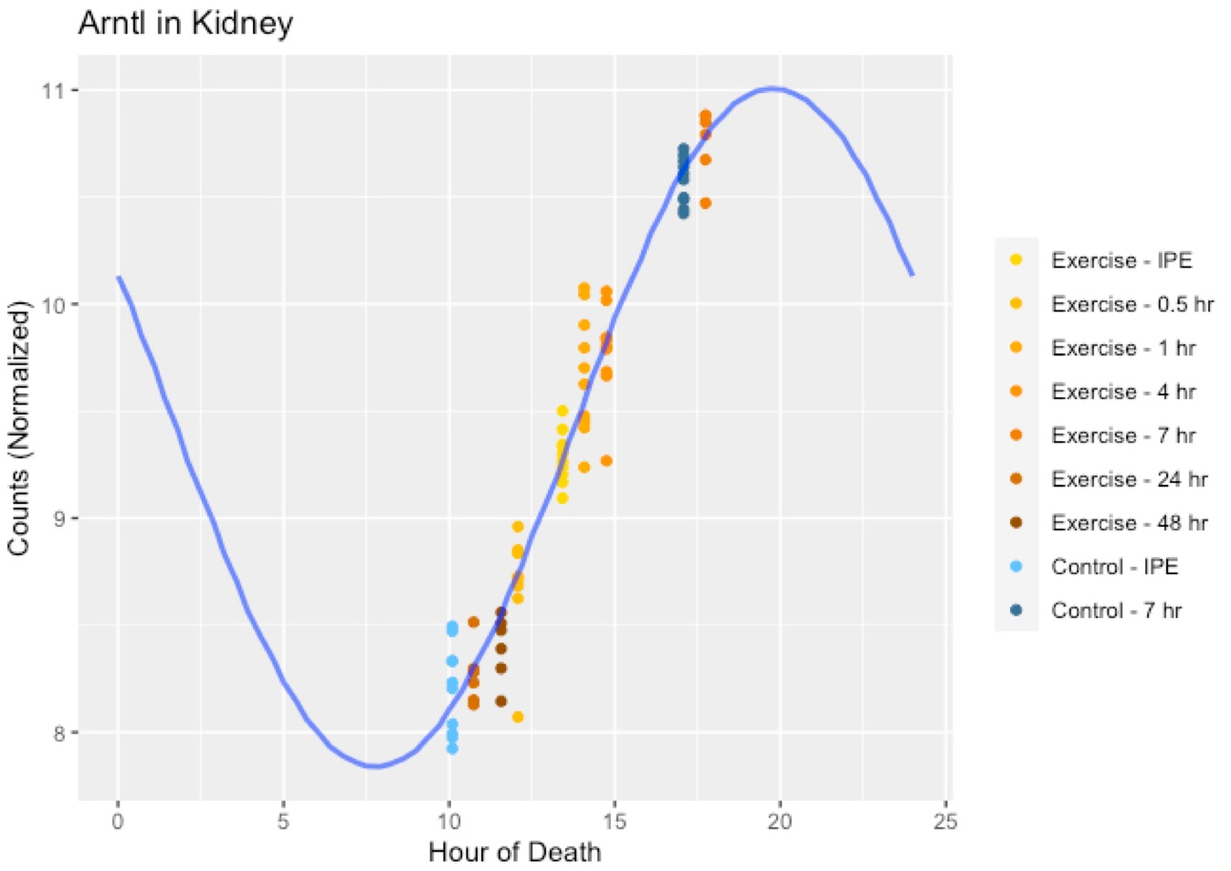
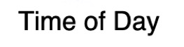
The Goal of this Analysis
We model contribution of circadian & exercise effects
Compare variance explained by circadian effects & exercise effects
We present experiments in data
We summarize results for each gene across 15 tissues
Potentially differentiate circadian rhythm & responsive to exercise
Notes:
In this study:
We evaluate the relative contribution of circadian and exercise effects by modeling the joint presence of both, and comparing the most likely amounts of variance explained by each.
We summarize the results for all genes, and compare across 15 tissues.

Slide 15
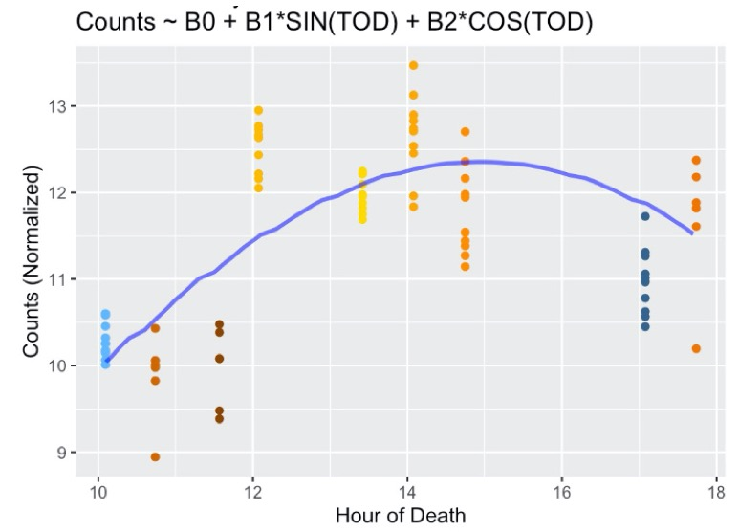
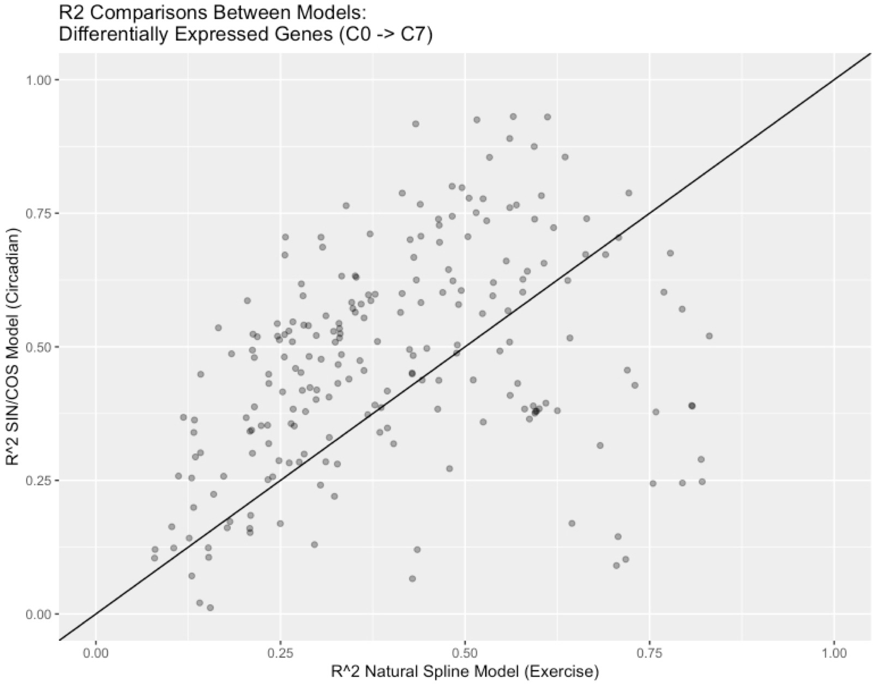
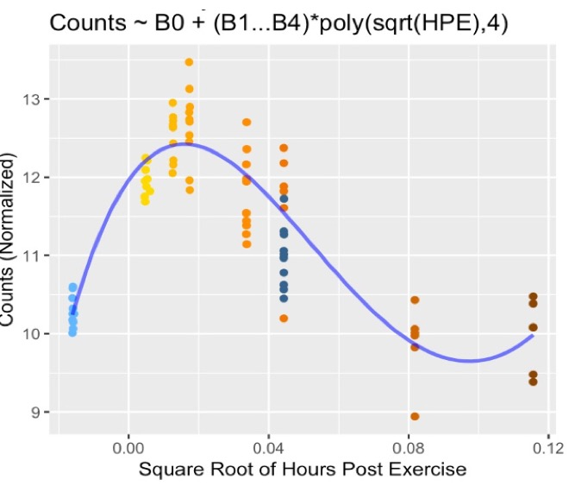
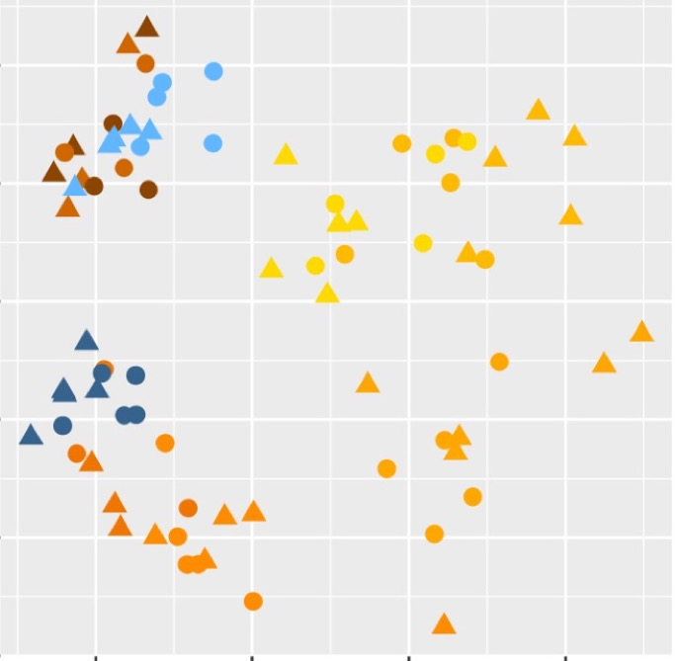
Data Foraging
Stage 1
Tissue Specific
Gene Specific
Model Circadian Rhythm
Tissue Specific
Variance Explained
By Models
Tissue Specific
RNASeq QC
Model Acute Exercise
Process Counts
Process Samples
PCA Analysis
Notes:
Add a list of major RNASeq QC Steps

Slide 16
Tissue Specific
Gene Specific
Model Circadian Rhythm
Tissue Specific
Variance Explained
By Models
Tissue Specific
RNASeq QC
Model Acute Exercise
Process Counts
Process Samples
PCA Analysis
Notes:
Add a list of major RNASeq QC Steps

Slide 17
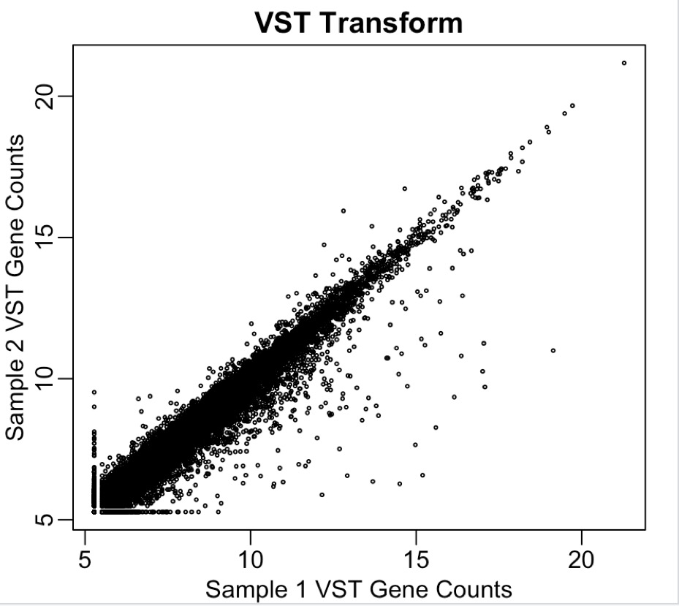
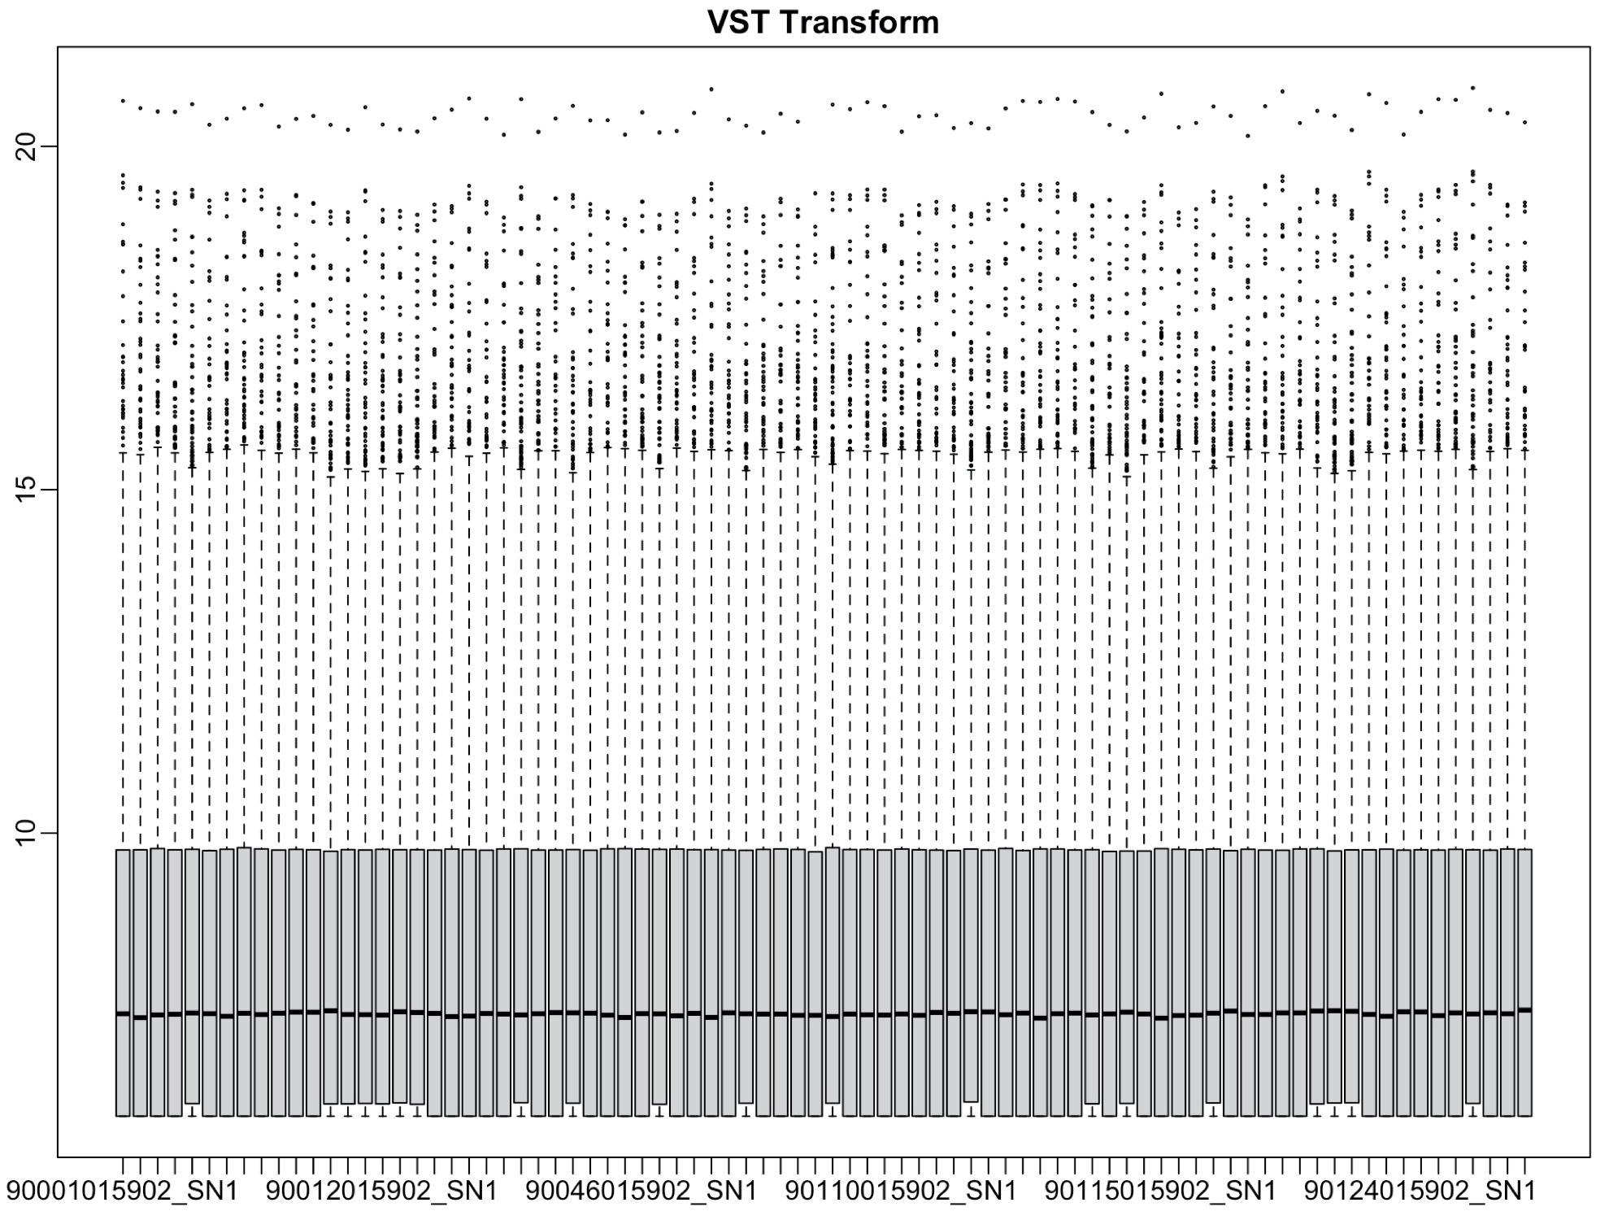
Count Processing

Slide 18
Sample Processing
Notes:
No genes were removed
Counts normalized with variance stabilizing transformation
vst() in DESeq2
Samples verified for sex
Covariates and batches adjusted
removeBatchEffect() in limma
Outlier samples removed

Slide 19
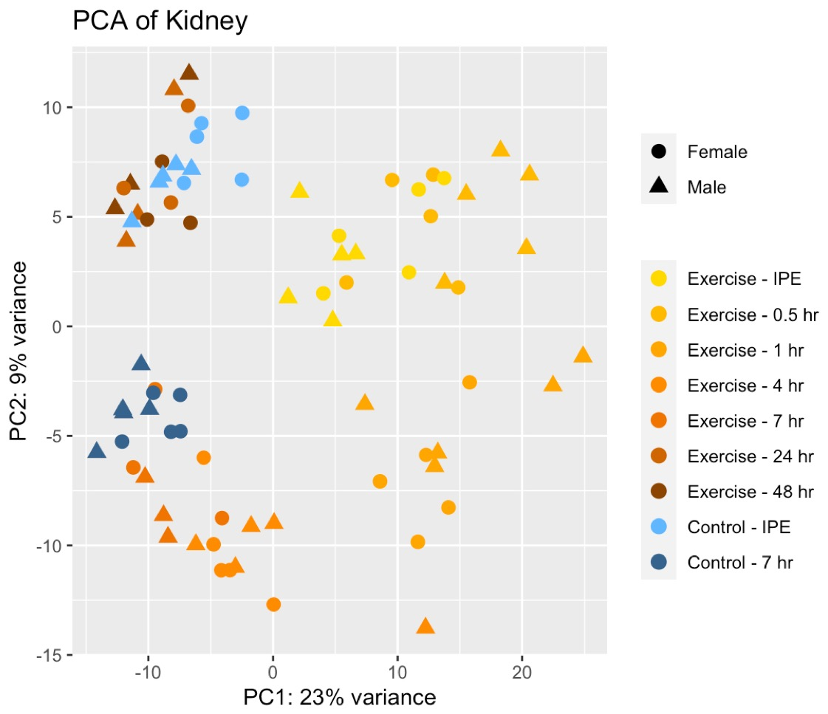
Global View in PCA of All Animals in One Tissue
Notes:
Realtive magnitude of how large the circle is and how long the line is

Slide 20
Global View in PCA of All Animals in One Tissue
Notes:
Realtive magnitude of how large the circle is and how long the line is

Slide 21
Global View in PCA of All Animals in One Tissue
Notes:
Realtive magnitude of how large the circle is and how long the line is

Slide 22
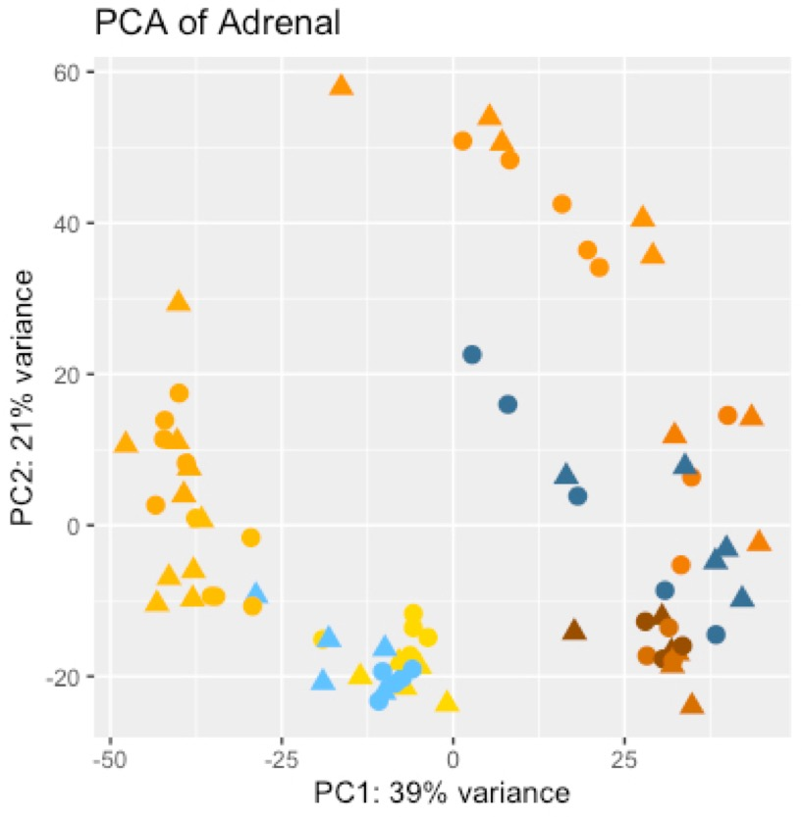
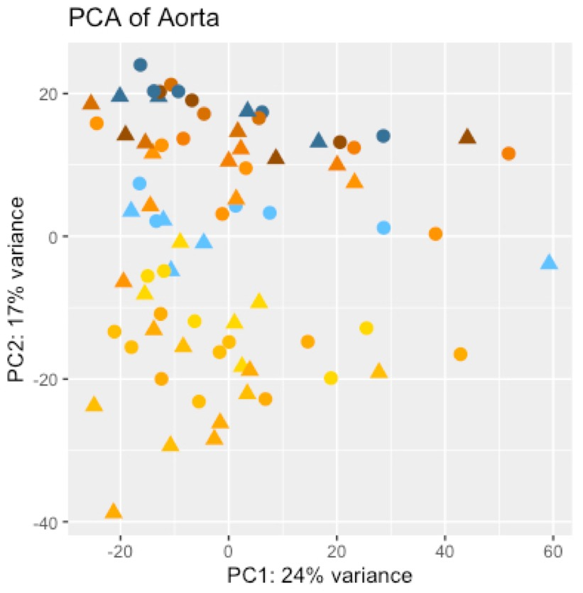
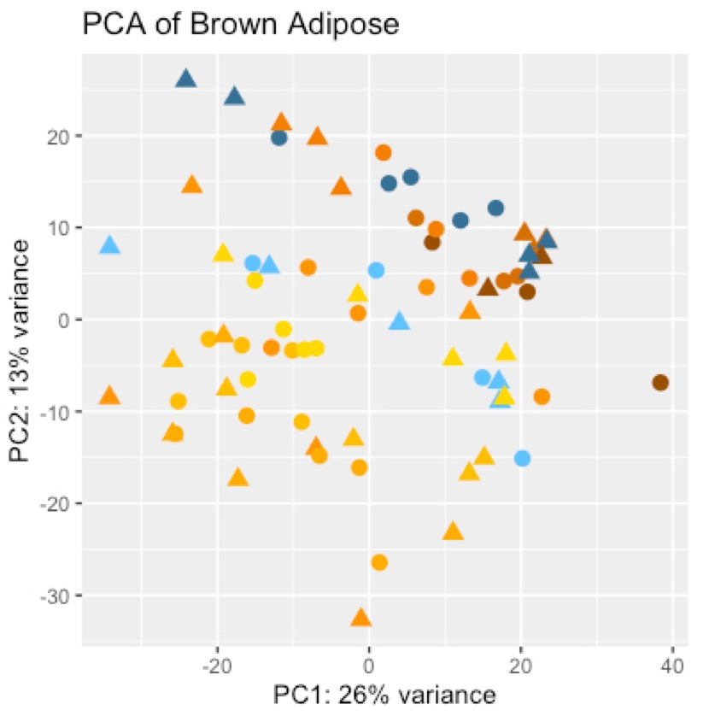
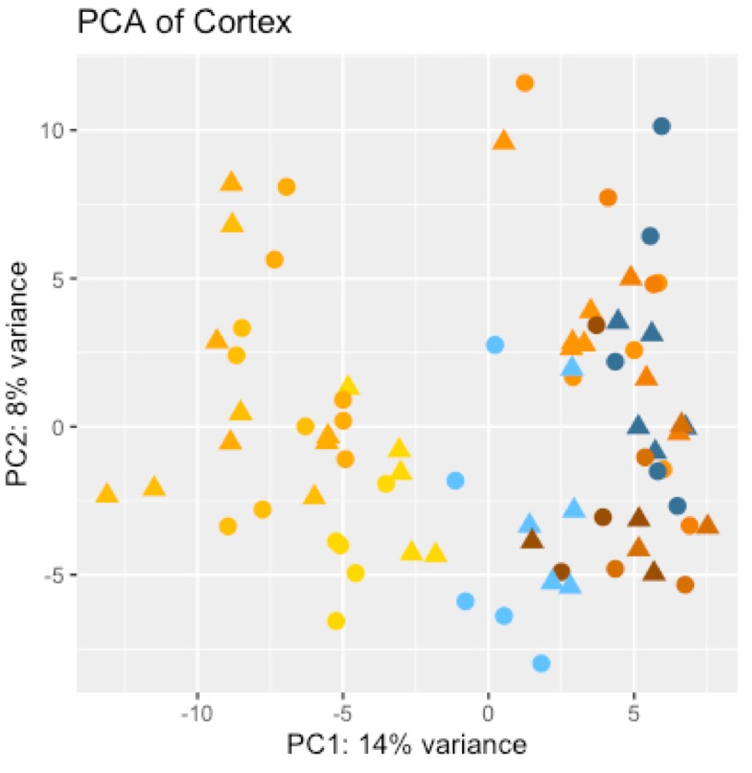
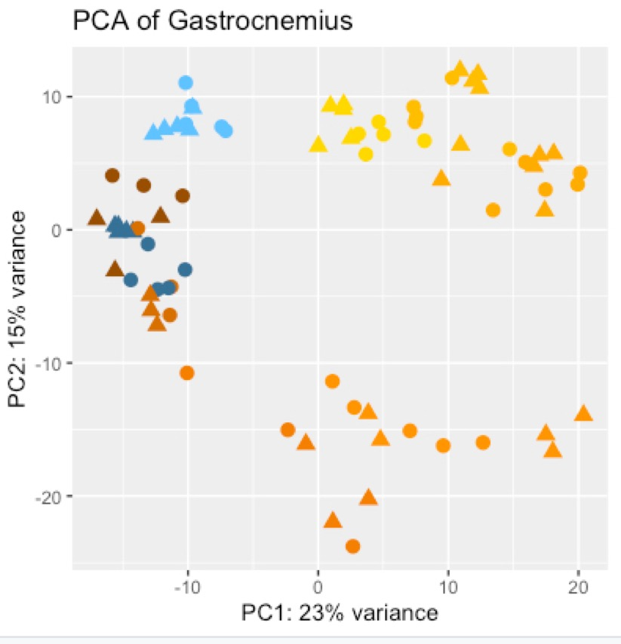
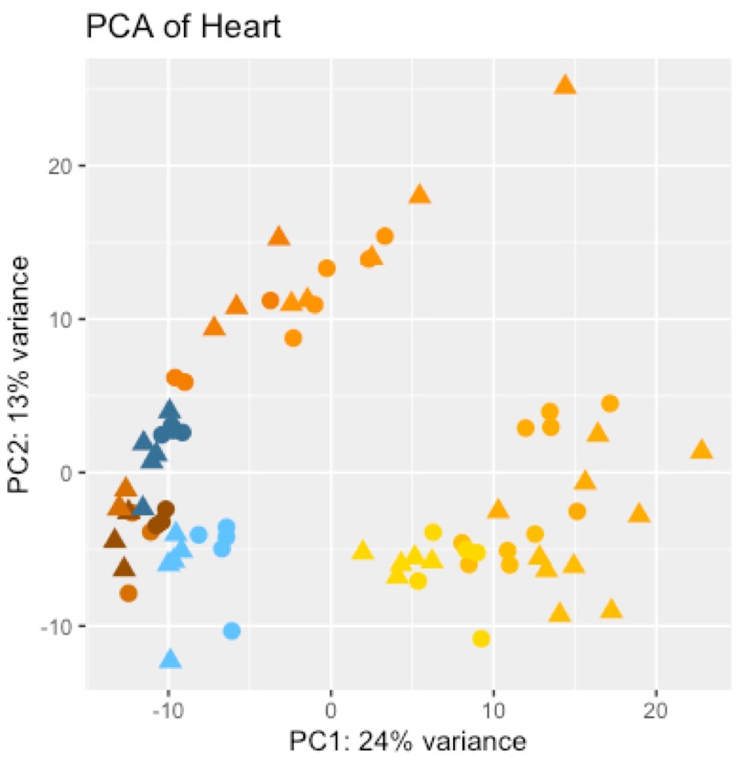
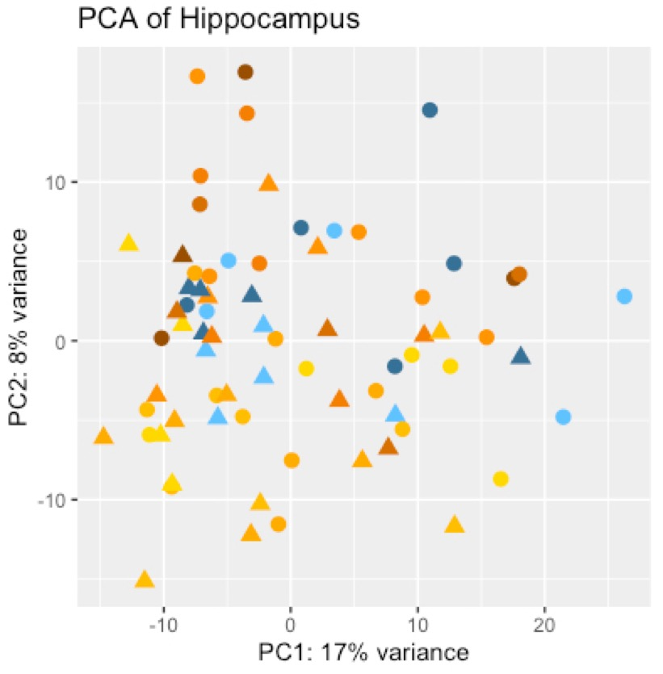
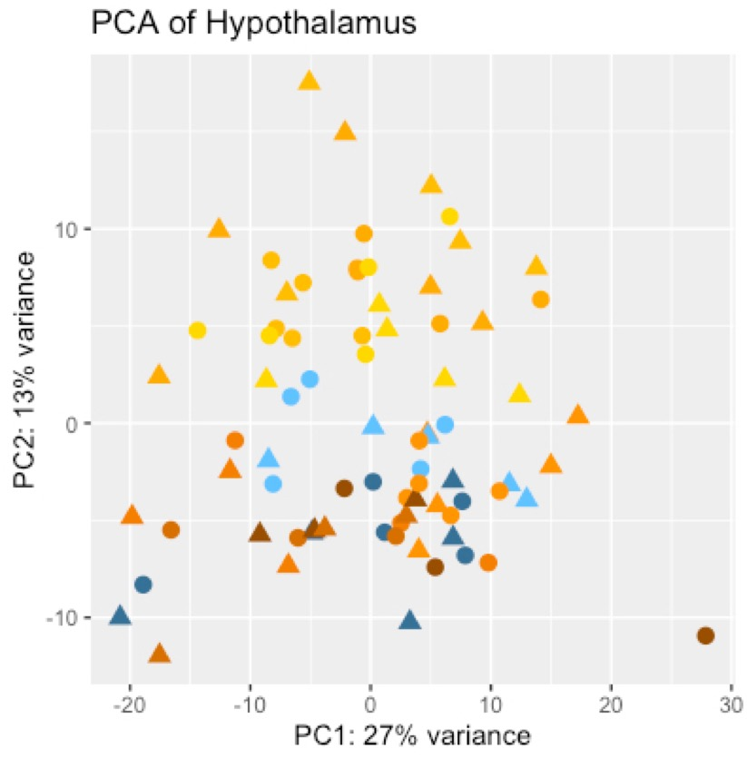
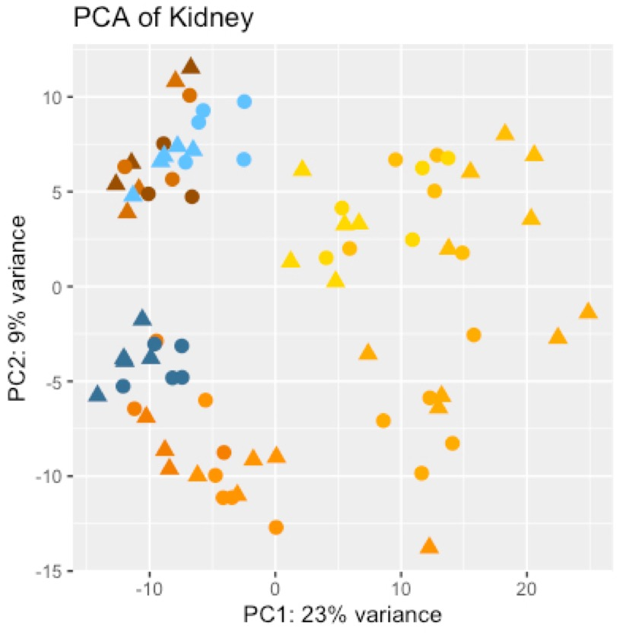
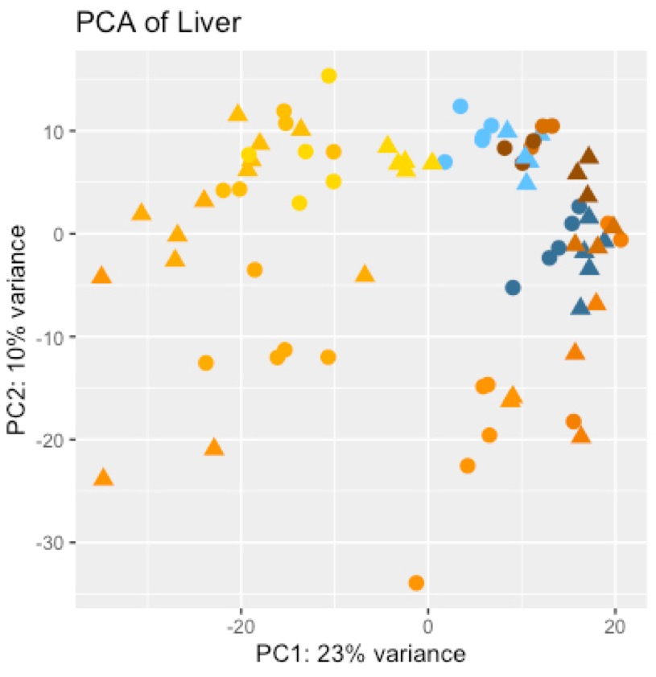
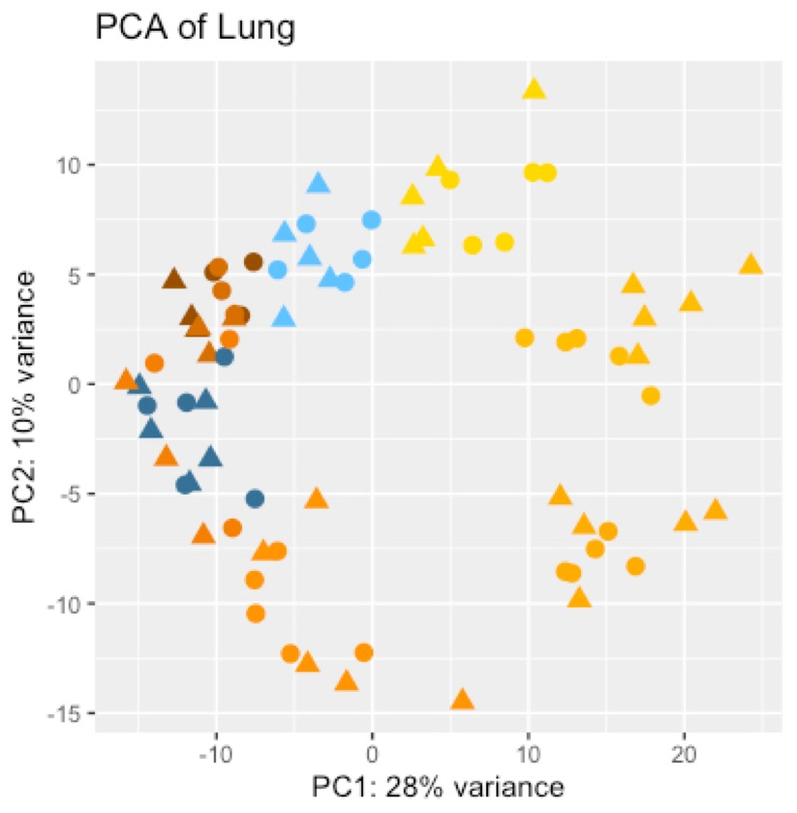
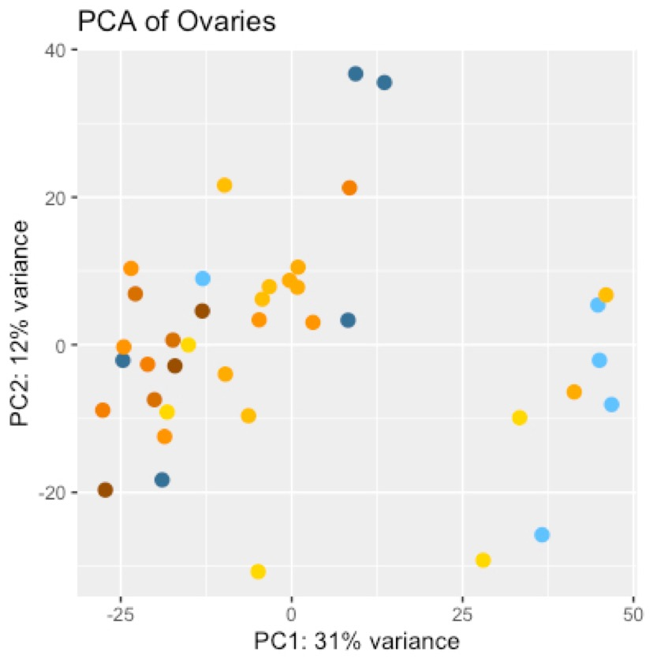
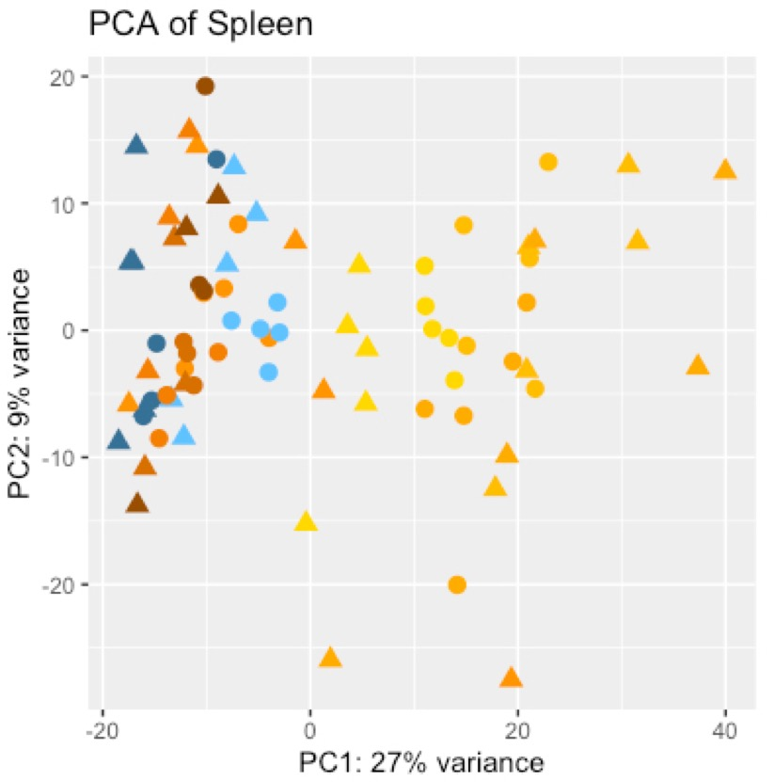
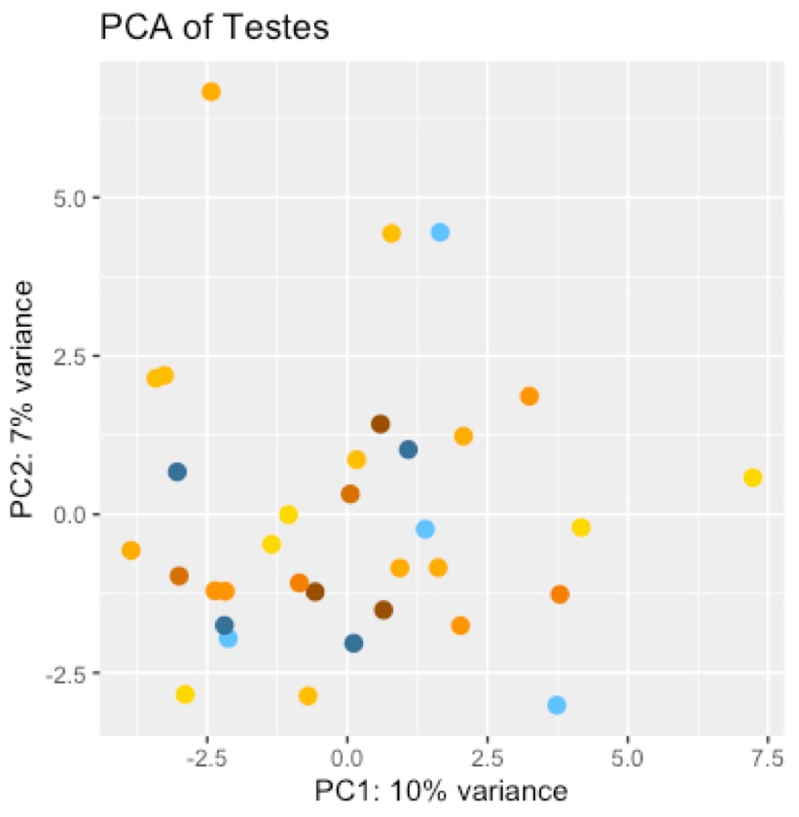
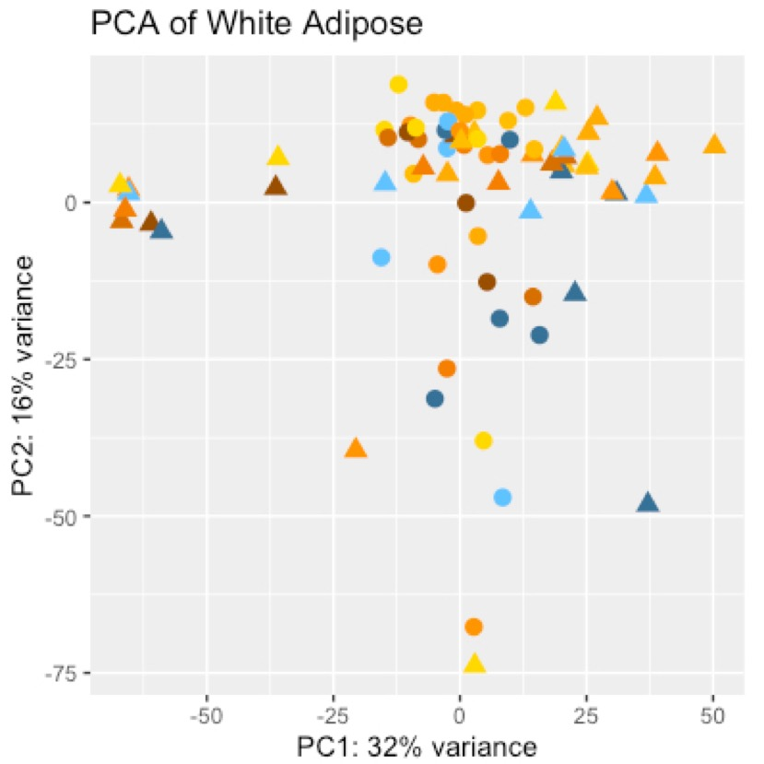
Notes:
Add Elipses to PCAs

Slide 24
Tissue Specific
Gene Specific
Model Circadian Rhythm
Tissue Specific
Variance Explained
By Models
Tissue Specific
RNASeq QC
Model Acute Exercise
Process Counts
Process Samples
PCA Analysis
Notes:
Add a list of major RNASeq QC Steps

Slide 25
Model Design
Model 1: Acute Exercise Response
Polynomial Model:
exp_{i} ~ B₀ + B₁(x_{e}) + B₂(x_{e})² + B₃(x_{e})³ + B₄(x_{e})⁴
exp_{i} = Gene Expression
x_{e} = √ Hours Post Exercise
Samples:
x-axis: Hours Post Exercise
Control 0hr + Exercise cohorts
Order: -1, 0, 0.5, 1, 4, 7, 24, 48
Notes:
Temporal modeling requires a minimal number of effective sampling points for a given functional pattern. For instance, a 3rd order polynomial function, ax³+bx²+cx+d, has 4 parameters. One of them is the baseline: coefficient "d", hence there are 3 degrees of freedom. A 4th order polynomial can model more complex "waveforms", but will cost one more degree of freedom.
The advantage of polynomial functions is that they do not prescribe the likely shape of the trajectories. However, a drawback is that later timepoints tend to exert a greater weight if not properly supervised. This is because x³ and x² are much larger than x for large x's, such as x=24 and 48. The usual approach of linear modeling will try to minimize the total squared error over all time points, therefore will overfit the 24h and 48h data.

Slide 26
Model Design
Model 1: Acute Exercise Response
Polynomial Model:
exp_{i} ~ B₀ + B₁(x_{e}) + B₂(x_{e})² + B₃(x_{e})³ + B₄(x_{e})⁴
exp_{i} = Gene Expression
x_{e} = √ Hours Post Exercise
Samples:
x-axis: Hours Post Exercise
Control 0hr + Exercise cohorts
Order: -1, 0, 0.5, 1, 4, 7, 24, 48
Model 2: Circadian Rhythm
SIN/COS Model:
exp_{i} ~ B₀ + B₁SIN(x_{c} ) + B₂COS(x_{c} )
exp_{i} = Gene Expression
x_{c} = 2π*(Time of Day)/24
Samples:
x-axis: Time of Day
Control 0hr + Exercise cohorts
Order: 10:00 – 18:00
Notes:
Circadian pattern can be modeled, in its simplest form, as a sinusoidal curve with an assumed 24h period, with 3 parameters: baseline, magnitude, and phase. An equivalent function is: a + b*sin(x') + c*cos(x'), where x' is 2*pi*T/24, T is the real time of tissue collection in the day, not the interval after exercise, x, used in the polynomial or Impulse function described above.
Note that the sine-cosine function above does not accommodate fast changes, either due to sudden changes in a narrow time window, or twice-daily rhythms (i.e., ultradian patterns).
For modeling circadian patterns we have 7 exercised groups and 2 control groups (Figure 4). But since 24h and 48h are considered nearly the same as the 0h control point, and due to the uneven distribution, the true effective number of sampling points is much fewer than 7, covering 10 am, 11am-noon, ~1 pm, and 5-6 pm.

Slide 27
Example Gene Modeled by Acute Exercise Response Model (Pdk4 in Kidney)

Slide 28
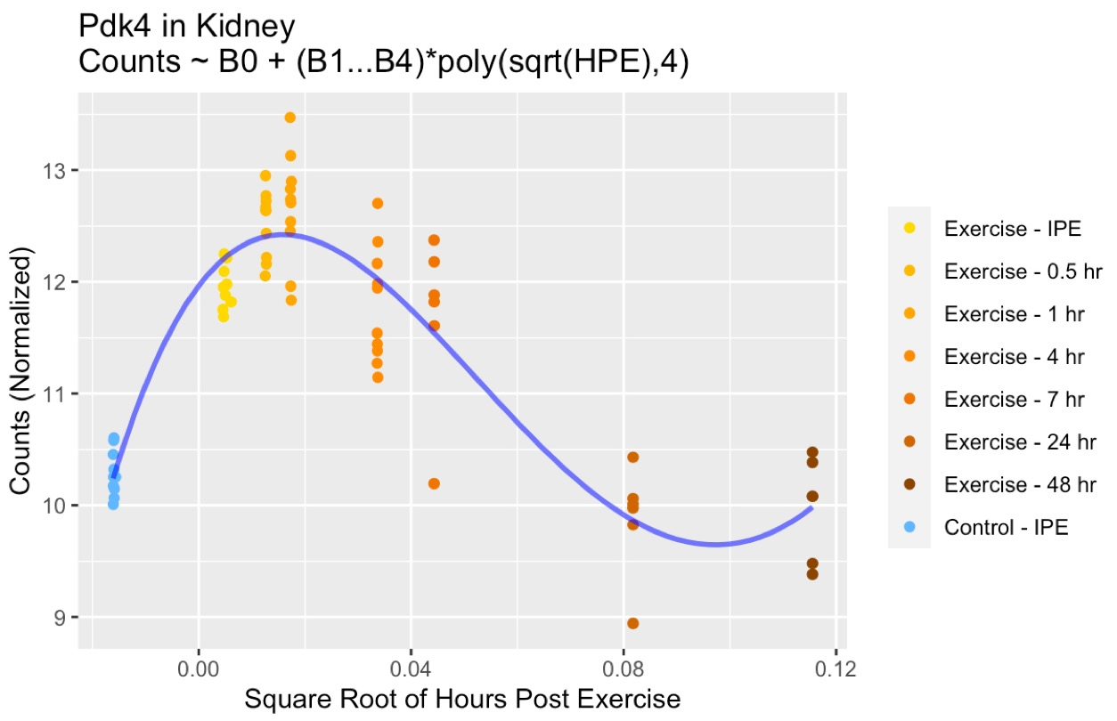
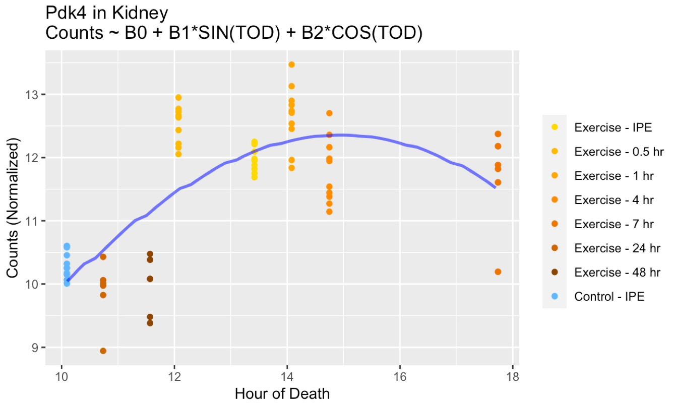
Exercise Model in Kidney (Example: Pdk4)
PVE = 0.834
R2 = 0.829
p-value < 2.2e-16
PVE = 0.593
R2 = 0.516
p-value = 2.13e-11

Slide 29
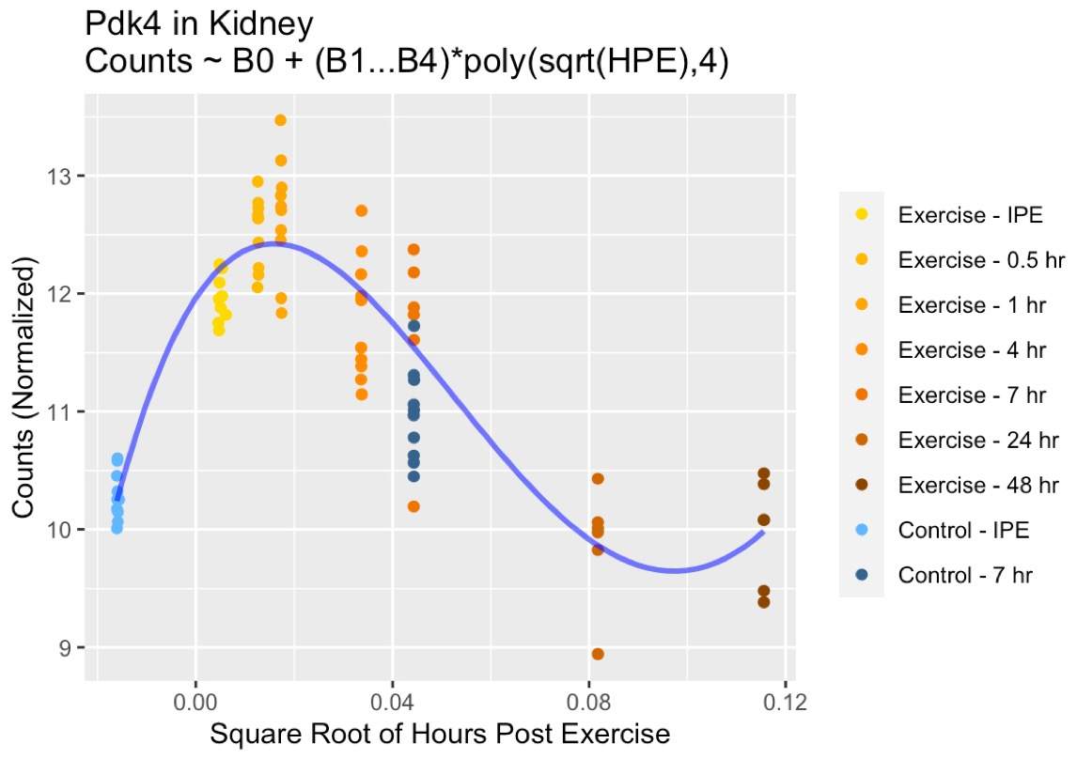
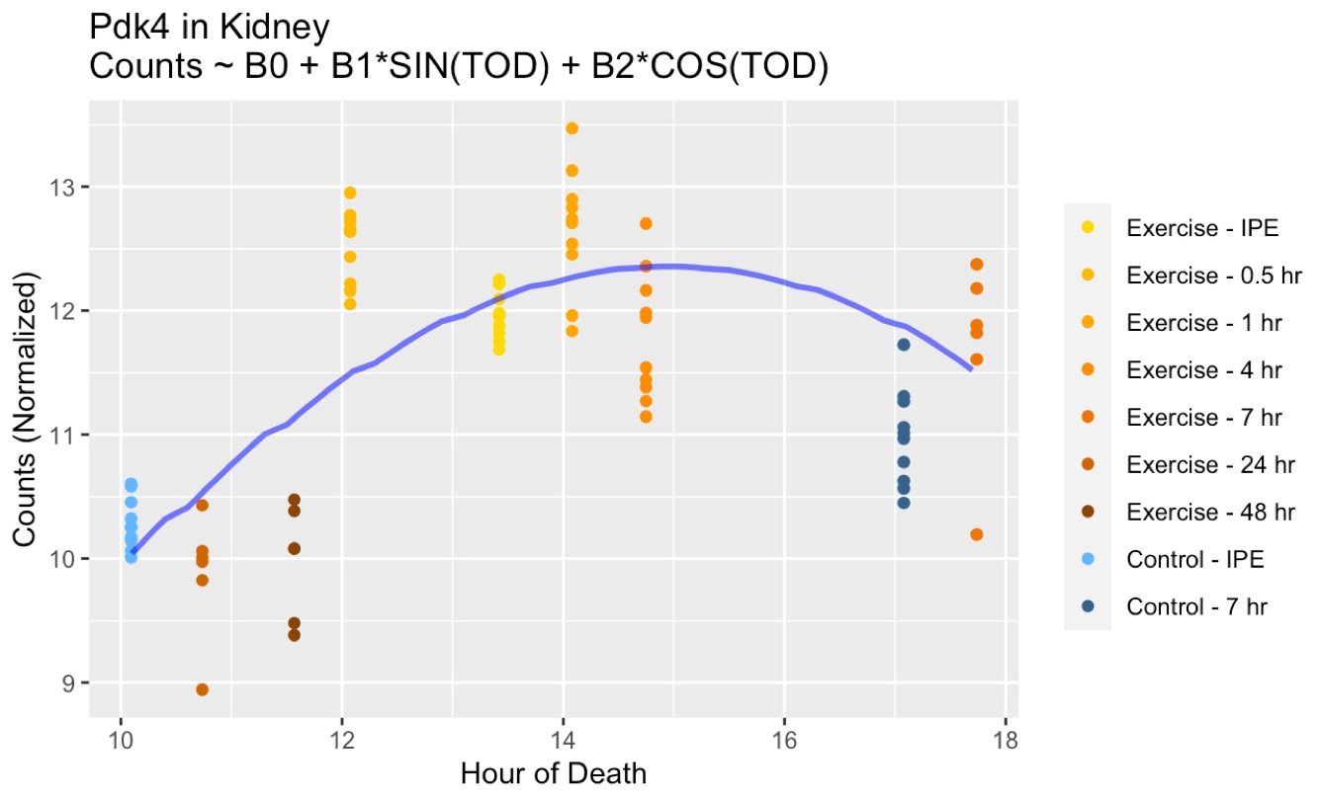
Exercise Model in Kidney (Example: Pdk4)
PVE = 0.834
R2 = 0.829
p-value < 2.2e-16
PVE = 0.593
R2 = 0.516
p-value = 2.13e-11

Slide 30
Example Gene Modeled by Circadian Rhythm Model (Arntl in Kidney)

Slide 31
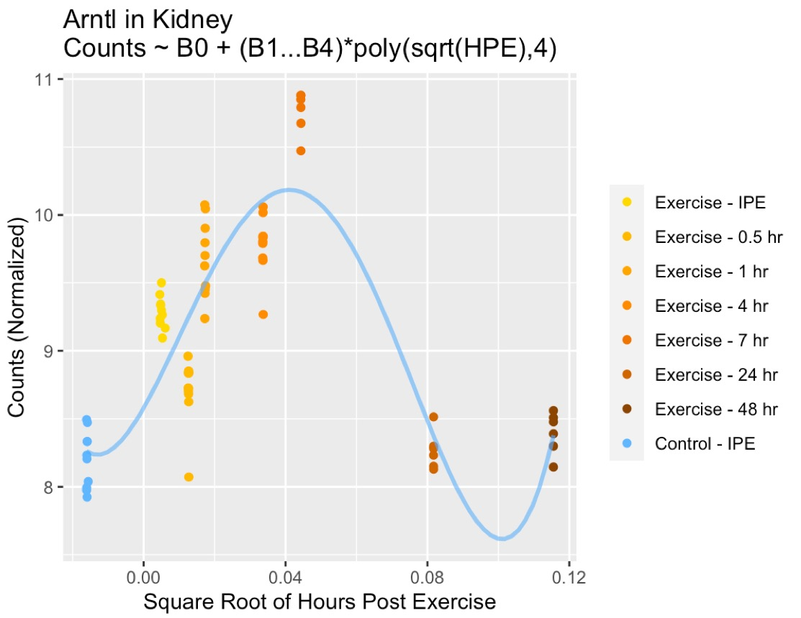
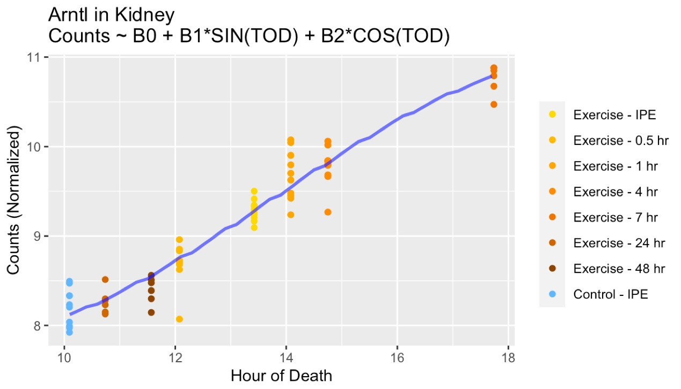
Circadian Model in Kidney (Example: Arntl)
PVE = 0.741
R2 = 0.723
p-value < 2.2e-16
PVE = 0.858
R2 = 0.931
p-value < 2.2e-16

Slide 32
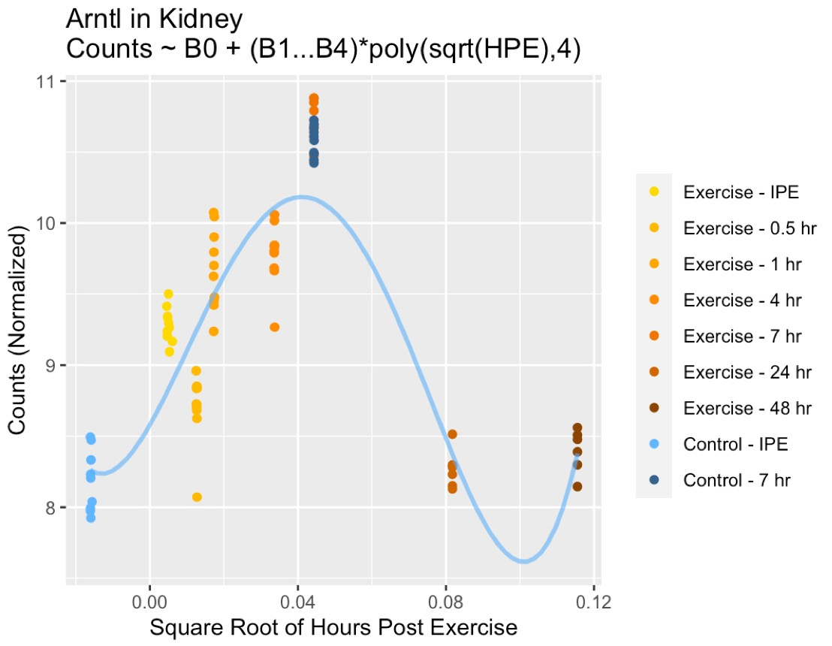
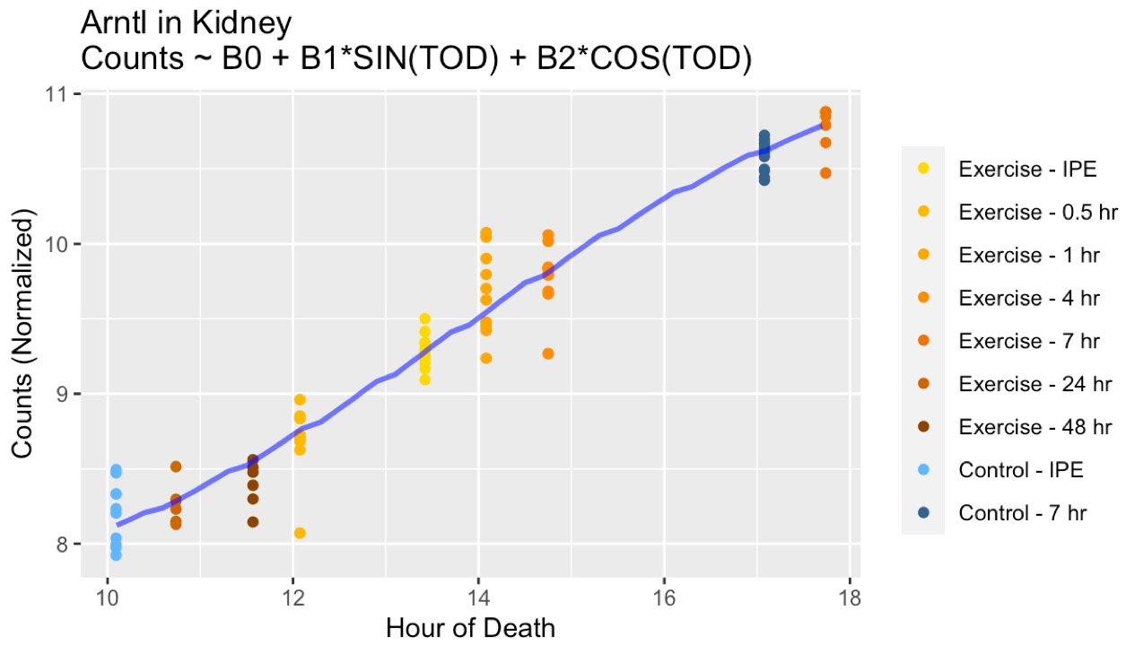
Circadian Model in Kidney (Example: Arntl)
PVE = 0.741
R2 = 0.723
p-value < 2.2e-16
PVE = 0.858
R2 = 0.931
p-value < 2.2e-16

Slide 33
Tissue Specific
Gene Specific
Model Circadian Rhythm
Tissue Specific
Variance Explained
By Models
Tissue Specific
RNASeq QC
Model Acute Exercise
Process Counts
Process Samples
PCA Analysis
Notes:
Add a list of major RNASeq QC Steps

Slide 34
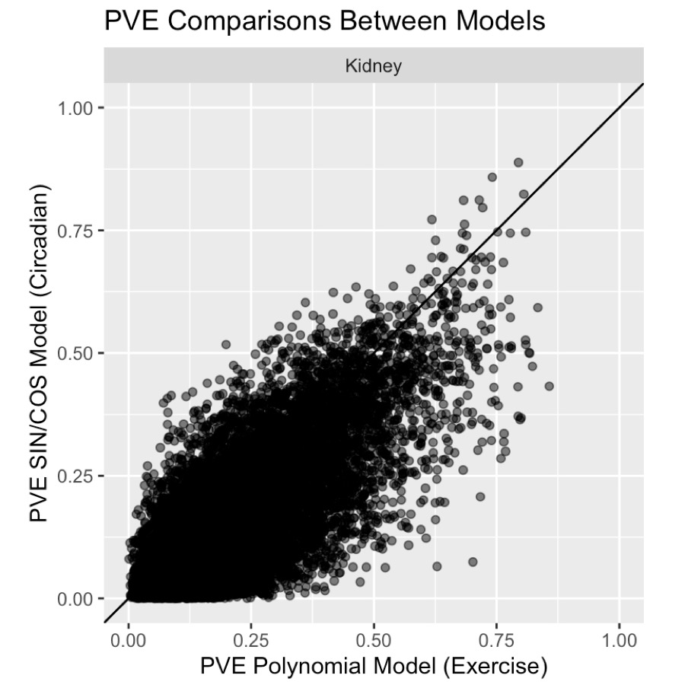
Variance Explained
Notes:
Add Arntl and Pdk4 into plot

Slide 35
If We Model Jointly, What is the Distribution of Variance Explained?

Slide 36
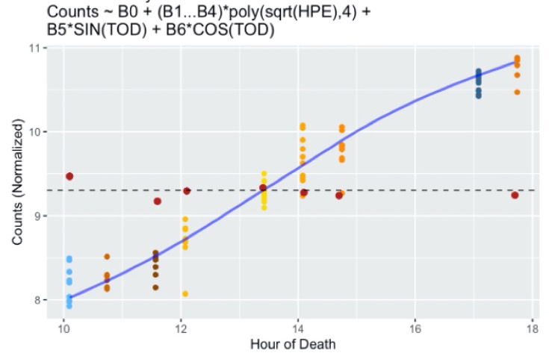
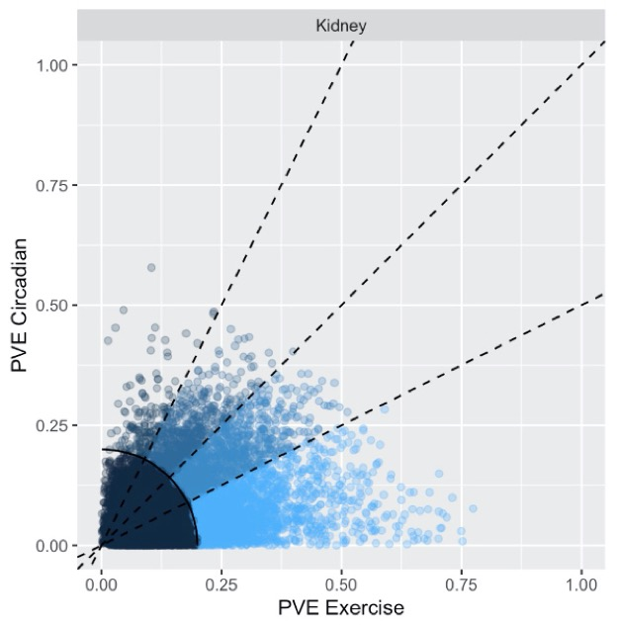
Combined Model
(Exercise + Circadian)
exp_{i} ~ B₀ + B₁(x_{e}) + B₂(x_{e})² + B₃(x_{e})³ + B₄(x_{e})⁴ + B₅SIN(x_{c}) + B₆COS(x_{c})
x_{e} = √ Hours Post Exercise
x_{c} = 2π*(Time of Day)/24
Data Foraging
Stage 2
Tissue Specific
Gene Specific
Tissue Specific
Tissue Specific
Joint (Combined) Model
Circadian + Exercise
Variance Explained
By Joint Models
RNASeq QC

Slide 37
Example Gene Modeled by Circadian Rhythm Model (Arntl in Kidney)

Slide 38
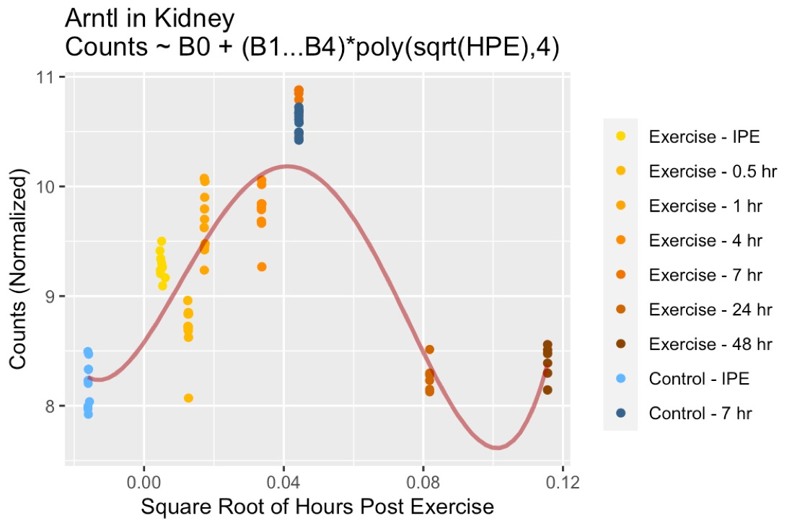

Slide 39
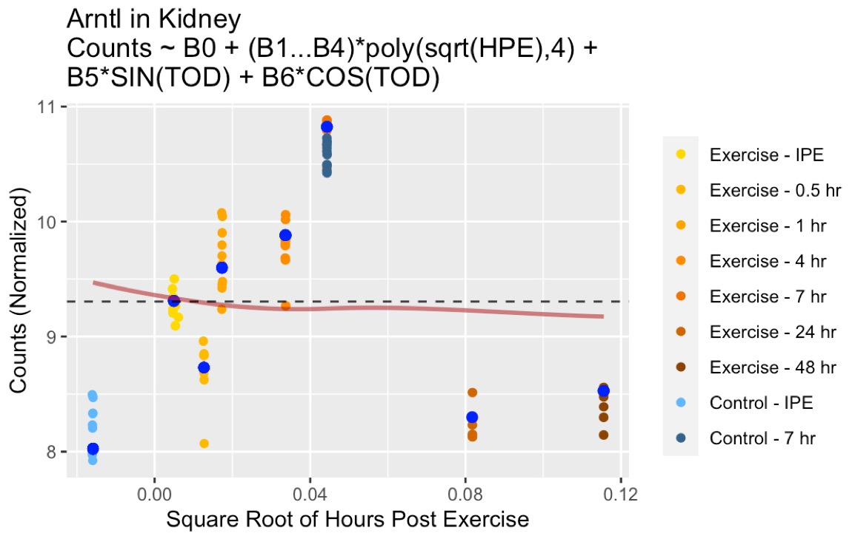
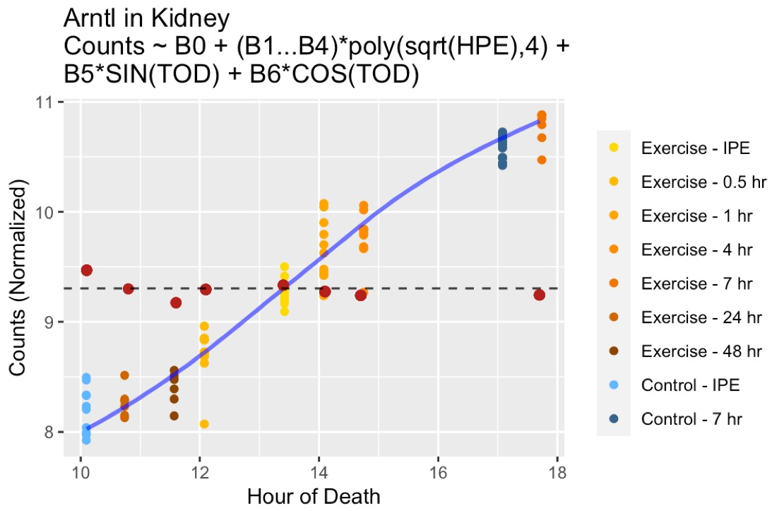

Slide 40
Example Gene Modeled by Acute Exercise Model (Pdk4 in Kidney)

Slide 41
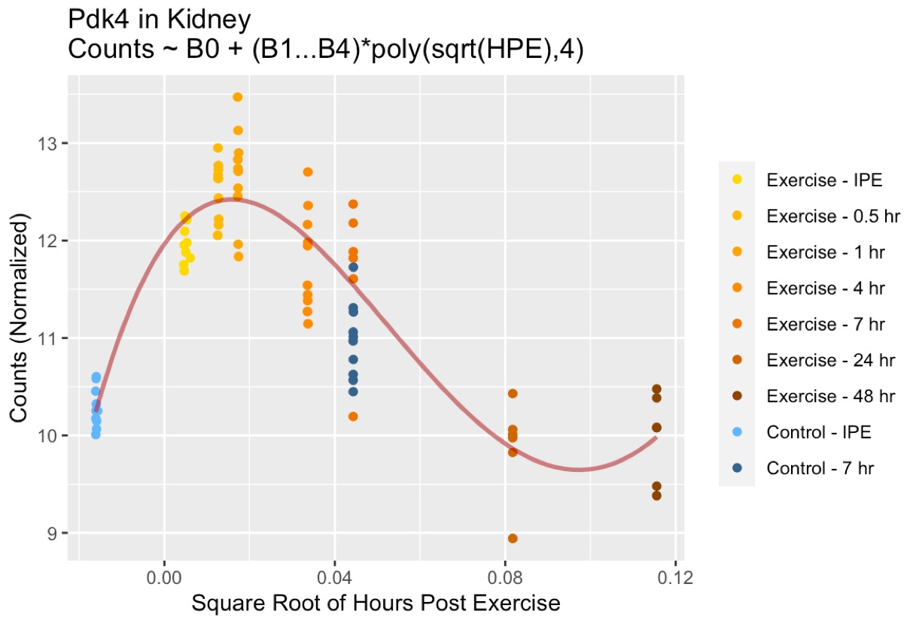

Slide 42
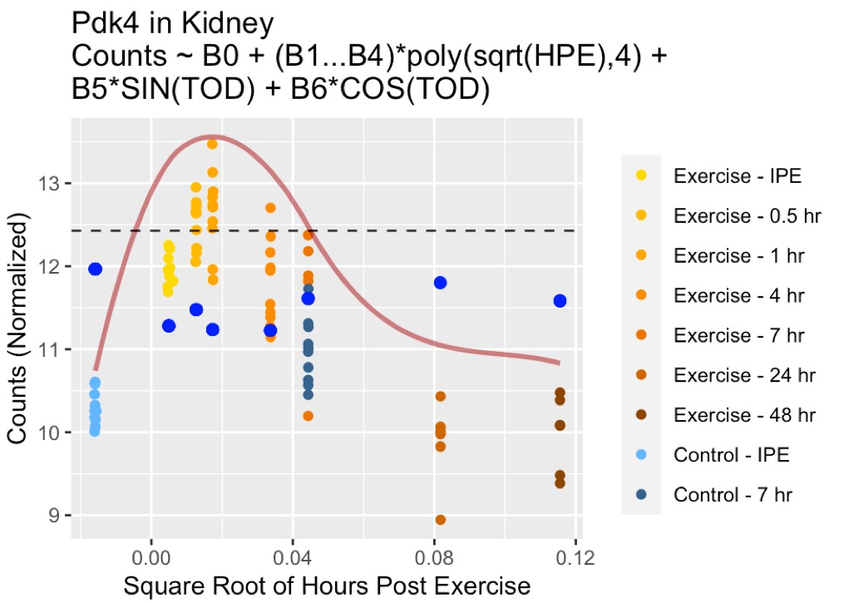


Slide 43

PVE: Separate Models vs Combined Model
Notes:
TODO: Add Gene Counts

Slide 44

PVE: Single Models vs Combined Model
Notes:
0 percent to 100 percent
Together cannot exceed 100 percent– show wedge

Slide 45
PVE: Single Models vs Combined Model
Notes:
Add Arntl and PdK4 into plot
Add diagnol line on right plot
0 percent to 100 percent
Together cannot exceed 100 percent– show wedge

Slide 46

Gene Groups by Tissue
1
2
3
4
0
Notes:
TODO Update the gene group

Slide 47

Gene Groups by Tissue
1
2
3
4
0
0
4
3
2
1
Notes:
TODO: Add Gene Frequencies

Slide 48

KEGG (Mouse 2019) Pathway Enrichment for Gene Groups Shared Across Tissues
*Gene Sets: The the unions of clustered genes that appear in 1 or more tissue
Notes:
All genes in any sector – 1,2,3,4 when we we take all the genes from any genes
Group 1 genes, no other pathways enriched

Slide 49
Frequency of Annotation by Gene Group (KEGG Circadian Rhythm Genes, Mouse 2019)
Notes:
Strong Circadian Genes ending up in groups 2,3,4
These may represent circadian genes that are responsive to exercise
We think we can correctly identify circadian rhythm genes that are

Slide 50
Frequency of DE Genes (C0 - > C7) by Gene Group

Slide 51
Notes:
Add Elipses to PCAs

Slide 52
Contributions
Joint modeling (C&E) to address for deficiency in exercise design
Global summary of relative effect
Exercise effect stronger for most genes in most tissues (experiments in data)
Results varied by tissue
Most hallmark circadian genes in gene groups 1 & 2
However, also in groups 3 & 4 – Circadian Genes that respond to Exercise?
Identical analysis frameworks in other omes
Different placement of sample points may show different patterns
Continue to improve modeling approach
Notes:
Joint Modeled to address Deficientcy in exercise design

Slide 53
Thank You
Karyn Esser, PhD
Nicole Gay
David Amar, PhD
Pierre Jean-Beltran, PhD
David Presby, PhD
David Jimenez-Morales, PhD
Surendra Dasari, PhD
Ching-ju (Jane) Lu, MPH
Terra R Coakley
Jiayu Zhang
Yanling Zhang, PhD
Jun Z. Li, PhD
Charles Burant, MD, PhD

Slide 54

Notes:
PASS1A has 7 sampling points for modeling the response function, with the challenge that they are concentrated in the first 4 hours. For the Impulse function, the model is identifiable if we have at least 3 points describing the up-phase and at least 3 points describing the down-phase. Since we only have 7 points plus a pre-exercise baseline: C0, IPE (E0), E0.5, E1, E4, E7, E24, and E48, features that do not show an up-and-down pattern in the middle of the series will not be adequately modeled (see below, 3B).
An "Impulse" function with a sigmoidal up-phase and sigmoidal down-phase would need 3 parameters for the magnitude (the level before, peak, after), 2 for the time of change (midpoints of up- and down-phase), and 2 for the rate (up-rate and down-rate), for a total of 7 parameters, even without modeling the curvature of the sigmoidal functions.
If we assume that the on-slope and the off-slope are equal, the model is reduced from 7 to 6 parameters.
Temporal modeling requires a minimal number of effective sampling points for a given functional pattern. For instance, a 3rd order polynomial function, ax³+bx²+cx+d, has 4 parameters. One of them is the baseline: coefficient "d", hence there are 3 degrees of freedom. A 4th order polynomial can model more complex "waveforms", but will cost one more degree of freedom.
The advantage of polynomial functions is that they do not prescribe the likely shape of the trajectories. However, a drawback is that later timepoints tend to exert a greater weight if not properly supervised. This is because x³ and x² are much larger than x for large x's, such as x=24 and 48. The usual approach of linear modeling will try to minimize the total squared error over all time points, therefore will overfit the 24h and 48h data.

Slide 55

Joint Model of Exercise Response and Circadian Pattern
Y_C (Circadian)
Y_E (Exercise)
Y_R (Residual)

Slide 56

Separate Models of Exercise Response and Circadian Pattern
Notes:
Recolor these values similar to PCA
Put plots on same slide

Slide 57


Joint Model of Exercise Response and Circadian Pattern
Y_C (Circadian)
Y_E (Exercise)
Y_R (Residual)

Slide 58
Separate Modeling of Exercise Response and Circadian Pattern

Slide 59


Covariate Adjustment
RNASeq QC

Slide 60
Model Design
Model 1: Acute Exercise Response
Polynomial model:
counts ~ B₀ + B₁(HPE)⁴ + B₂(HPE)³ + B₃(HPE)² + B₄(HPE)
HPE = Hours Post Exercise (square root)
Samples:
x-axis: Hours Post Exercise
Control 0hr + Exercise cohorts
Order: -1, 0, 0.5, 1, 4, 7, 24, 48
Model 2: Circadian Rhythm
SIN/COS Model:
counts ~ B₀ + B₁SIN(TOD) + B₂COS(TOD)
TOD = Time of Death
Samples:
x-axis: Time of death (time of day)
Control 0hr + Exercise cohorts
Order: 10:00 – 18:00
“Test Sample”:
Control 7hr

Slide 61
Control Groups Demonstrate Differential Counts
Acute Exercise Cohorts
0hr
1/2hr
1hr
4hr
7hr
24hr
48hr
Sedentary Cohorts

Slide 62
DE Genes (C0 -> C7) Pathway Enrichment
Pathway Enrichment
RNASeq QC
DE analysis
Process Reads
Outliers
Duplicated
MIS-ID Samples
PCA
Batch Effects
DESeq2
FDR <= 0.05 Log2FC > 0.25
Top 20 Genes
(labeled)
Enrichr
Hypergeometric
KEGG Mouse
(2019)
Notes:
-Slide 5 & 6: Adjust titles of all plots, adjust formulas, adjust Tissue names

Slide 63
Differentially Expressed Genes Between C0 and C7 Samples in Kidney
DE analysis
DESeq2
Adj p-val < 0.05 (Bonferroni)
Log2FC > 0.25
Top 20 Genes
(labeled)
Notes:
-Adjust MA plot title
-Note that top 20 genes are labeled
-Adjust size of up and down dots
-Adjust NS to Not significant
-Create another slide with MA plots for all tissues

Slide 64
Circadian Rhythm Pathways Enriched in DE Gene Sets
Pathway Enrichment
Enrichr
Hypergeometric
KEGG Mouse
(2019)
Notes:
-Get the Pool of KEGG Circadian Genes
-Adjust Title
-Follow this slide with a slide for all Pathways facetted by tissue
-In following slide: Show list of genes DE across multiple tissues ranked by shared tissue number, then demonstrate the overlap with KEGG pathway

Slide 65
Comparison of Transforms
Log2
Variance Stabilizing Transformation (VST)
Regularized Log (rlog)
Notes:
Log2 normalization (with size factor and pseudo count)
Variance stabilizing transformation (VST) uses a subset of genes and divides each column of the counts matrix by our size factors. It also normalizes with respect to library size.
The purpose of using the "regularized log" transformation is to shrink together the values of the genes that have very low counts ("shrinkage" technique in statistics). Rlog is close to log2 transform.

Slide 66

Notes:
Log2 normalization (with size factor and pseudo count)
Variance stabilizing transformation (VST) uses a subset of genes and divides each column of the counts matrix by our size factors. It also normalizes with respect to library size.
The purpose of using the "regularized log" transformation is to shrink together the values of the genes that have very low counts ("shrinkage" technique in statistics). Rlog is close to log2 transform.

Slide 67


Distribution of Variance (by Transform)
Raw Counts
Notes:
Returning to our prior plot of comparing expression of 2 samples, we can see the the variance is now more stable in VST and rlog transforms. However, the VST transform demonstrates a lot of variance in genes with low read counts. For that reason, we will proceed with rlog transform.

